Slide 1
2015 Microsoft MVP Virtual Conference
May 14 – 15, 2015
DevOps: What Is This Puppet You Speak Of?
Rob Reynolds Moderator: Keith Dahlby
14 May 2015

Slide 2



Rob Reynolds
Developer at
Creator of Chocolatey
MVP for .NET
Making your Windows world a better place
@ferventcoder
Notes:
Six time MVP, used to be in C# and most recently .NET

Slide 3


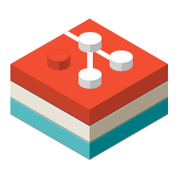
Keith Dahlby
Creator of
Works on LibGit2Sharp
MVP for .NET
Curator of Up-For-Grabs.net
@dahlbyk
Notes:
Six time MVP, used to be in C# and most recently .NET

Slide 4

Agenda
DevOps?
Puppet?
Windows Module Pack
Other Windows Modules
Demo
Questions

Slide 5
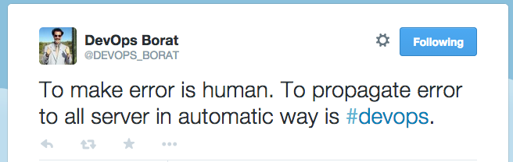
DevOps?
Notes:
DevOps is bringing development practices to operations, but it is more than that. It’s also bringing ops and QA into the development processes. A way to think about it is everything from source to production.

Slide 6
DevOps?
Source control
Continuous Integration
Testing infrastructure
agile practices (little “a” agile)
Part of project team
Notes:
DevOps is bringing development practices to operations, but it is more than that. It’s also bringing ops and QA into the development processes. A way to think about it is everything from source to production.

Slide 7
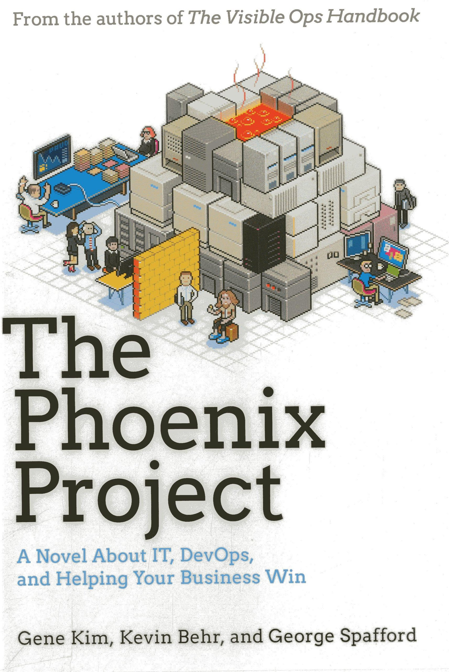
DevOps?
Fancy term for collaboration
Developers / QA / Operations
The Phoenix Project
Notes:
DevOps is bringing development practices to operations, but it is more than that. It’s also bringing ops and QA into the development processes. A way to think about it is everything from source to production.

Slide 8
Why Automation?
“I must have missed that step”
“I didn’t realize we were deploying that”
“I sort of followed your instructions, but I knew what I could skip”
“You need how many machines by when?”
“I’m setting up a new machine – see you in a few days!”
“Something has changed on this server”

Slide 9
Why Automation?
You ever hear any of that from a machine?

Slide 10
Why Automation?
Machines are much more reliable at scriptable tasks

Slide 11
Puppet?
“Puppet is IT automation software that helps system administrators manage infrastructure throughout its lifecycle, from provisioning and configuration to orchestration and reporting. Using Puppet, you can easily automate repetitive tasks, quickly deploy critical applications, and proactively manage change, scaling from 10s of servers to 1000s, on-premise or in the cloud.”
Notes:
This slide lasts for about 5-10 seconds while I trail off b/c it is tooo looooong

Slide 12
tl;dr - Puppet?
Infrastructure as Code
Provisioner
Server Automation / Assurance
Reduce Configuration Drift
The original desired state configuration
Automate repetitive tasks
Reports

Slide 13
Puppet – Windows Platforms
Servers: Windows Server 2003+
Desktops: Windows Vista+
Puppet comes as x86 or x64
Windows since 2011

Slide 14
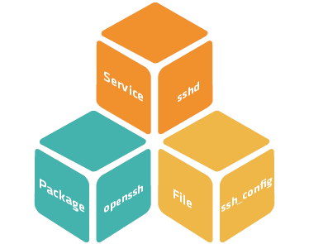
Puppet – Resource Types & Providers
Fundamental Building Blocks
Type is Package
Provider is Chocolatey

Slide 15
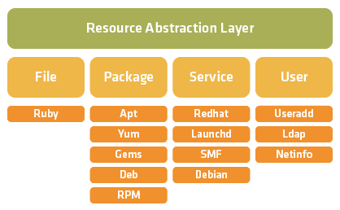
Puppet – Resource Types & Providers

Slide 16
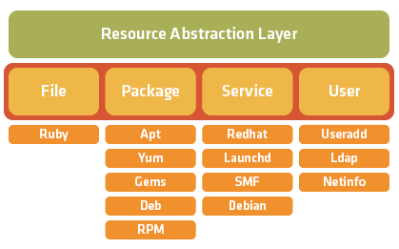
Puppet – Resource Types

Slide 17
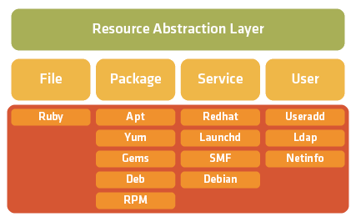
Puppet – Resource Providers

Slide 18
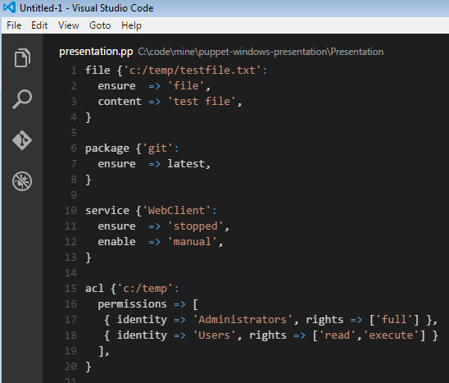
Puppet – Manifests
Puppet script file aka Manifest
*.pp files
Puppet Language
Can include / require other *.pp files
Can make up modules

Slide 19
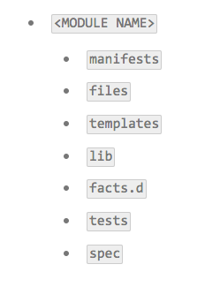
Puppet – Modules
Collections of manifests, files, custom facts, types and providers, etc
Best way to extend core Puppet
The Forge – 150+ Windows
More on Github
Notes:
3K modules, 150+ are Windows modules

Slide 20

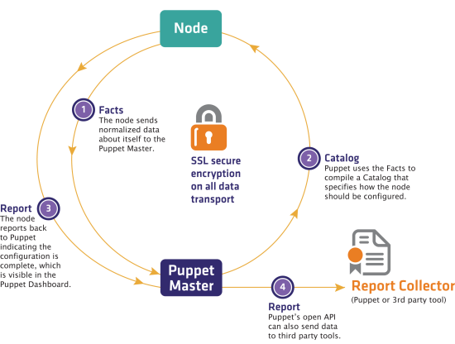
Anatomy of a Puppet Run

Slide 21
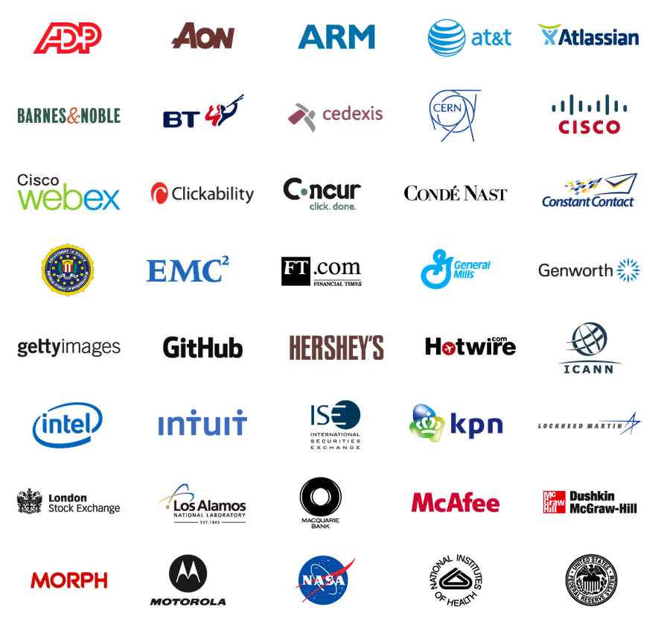
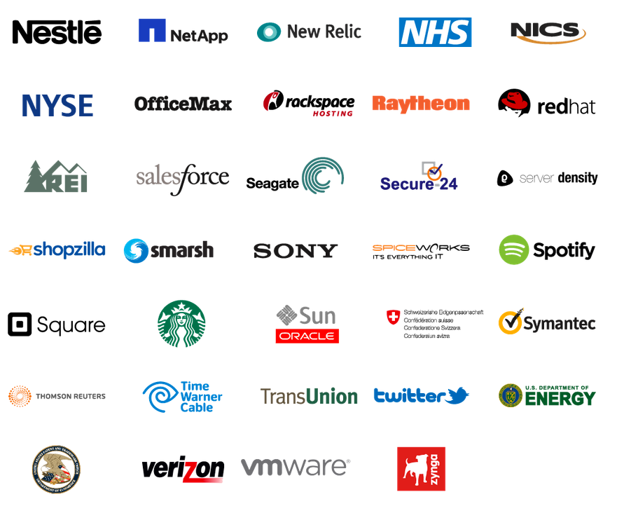
Who Uses Puppet?
Notes:
We have a very large user/customer base. These are the users we have listed on the puppetlabs dot com slash customers page.

Slide 22
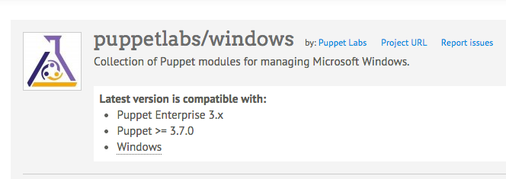
Windows Module Pack
Registry
PowerShell
Reboot
ACLs
Windows Features
IIS

Slide 23
Other Notable Windows Modules
Chocolatey Provider Module
PowerShell DSC Module
Active Directory Module
Windows Firewall
Windows Environment

Slide 24
Windows Resources
file
user
group
scheduled_task
package
service
exec
host
reboot
acl
windowsfeature
windows_env
iis::manage_site
registry_key
registry_value
More w/modules

Slide 25
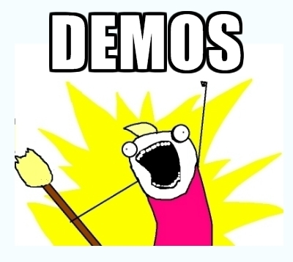
Demos

Slide 26
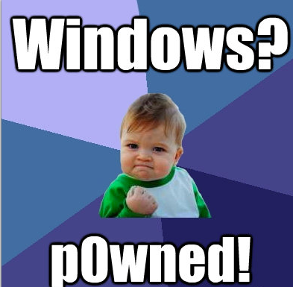

Questions / Reference
https://puppetlabs.com
https://docs.puppetlabs.com
https://docs.puppetlabs.com/windows
https://forge.puppetlabs.com/puppetlabs/windows
@ferventcoder

